Slide 1
Reinforcement Learning
BY:
SHIVIKA SODHI

Slide 2
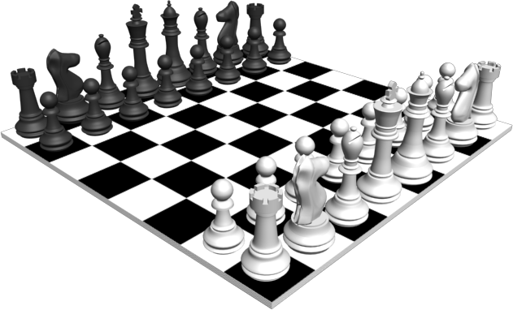
INTRODUCTION
Study - How agents can learn what to do in the absence of labeled examples.
Ex. In chess, a supervised learning agent needs to know about every correct move, but that feedback is seldom available.
Without a feedback of good/bad, the agent will have no ground for deciding what move to make. It needs to know If it (accidentally) checkmates: good or gets checkmated: bad. This kind of feedback is called reward/reinforcement.
The agent must be hardwired to recognize reward vs normal input

Slide 3
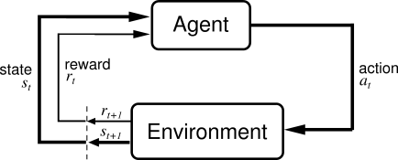
INTRODUCTION
Reinforcement learning uses observed rewards to learn an optimal policy.
Eg. Playing a game whose rules you don’t know, and after a few moves, your opponent announces ‘you lose’.
Feasible way to train a program to perform at high levels
The program can be told when its won or lost, use this info to learn an evaluation function that gives accurate estimates
Agent designs: Utility based: Uses a learnt utility function on state, to select actions that maximize the expected outcome utility Q-learning: learns action utility function, giving the expected utility Reflex agent: learns a policy that maps directly from states to actions

Slide 4
INTRODUCTION
Utility-based agent must have a model of environment to make decisions, as it must know the states to which its actions will lead.
Ex. To make use of a backgammon evaluation function, a backgammon program, must know what its legal moves are and how they affect the board position. (thus it can apply the utility function to the outcome states)
Q- learning agent doesn’t need a model of environment as it can compare the expected utilities for its available choices without needing to know their outcomes. They can’t look ahead as they don’t know where their actions will lead

Slide 5
PASSIVE REINFORCEMENT LEARNING
Agent’s policy is fixed. Goal is to learn how good the policy is [U^{pie}(s)]
This agent doesn’t know reward function or transition model. P(s’|s,a)
Direct utility estimation:
Utility of a state is the expected total reward from that state onward. Each trial provides a sample of this quantity for each state visited.
At the end of each sequence, the algo calculates the observed reward-to-go as output.

Slide 6
Direct utility estimation
Instance of supervised learning, input: state, output: reward-to-go
Succeeds in reducing the reinforcement learning problem to an inductive learning problem, (which is known)
Utility (each state) = own reward + utility (successor state)
Utilities are not independent, this model ignores that.
Hence this algorithm converges very slowly.

Slide 7
Adaptive Dynamic Programming
An ADP agent takes advantage of the constraints among the utilities of states by learning the transition model that connects them and solving the corresponding Markov decision process using a dynamic programming method.
Plugging the learned transition model and observed rewards into Bellman equation to calculate the utilities of the states.
Equations are linear.
Value iteration process can use previous utility estimates as initial values and should converge quickly.

Slide 8
Temporal Difference learning
Solving the underlying MDP is not the only way to bring the Bellman equations to bear on the learning problem.
Instead, use observed transitions to adjust utilities of observed states so that they agree with constraint equations.
This rule is called temporal difference because it uses the differences in utilities between successive states
TD doesn’t need a transition model to perform its updates.

Slide 9
ACTIVE REINFORCEMENT LEARNING
An active agent must decide what to take.
The agent will need to learn a complete model with outcome probabilities for all actions rather than just the model for fixed policy.

Slide 10
GENERALIZATION IN REINFORCEMENT LEARNING

Slide 11
POLICY SEARCH

Slide 12
APPLICATIONS OF REINFORCEMENT LEARNING

